Slide 1
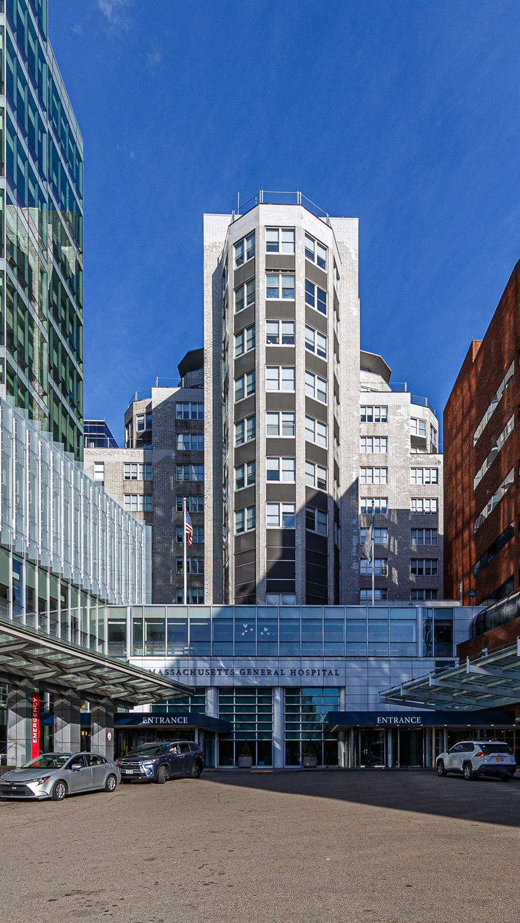


OPPORTUNITY REVIEW
DIRECT-TO-EMPLOYER GTM STRATEGY
Exploring a Mass General Brigham DTE Health Plan

Slide 2


Founded in 1979, headquartered in Indianapolis
Largest Independently-Owned Full-Service Third-Party Administrator
Specialize in Administration of Self-Funded Plans and Population Health Management​
Leader in the Direct-to-Employer Movement
We Know and Understand the Market
Experience Working with All Professional Teams: Agents, Networks, MGAs
The Key Family of Companies is a Vertically Integrated group of benefit related organizations
3,000+ Corporate Clients
3 Million Members under Management
700 Employees

Slide 3


MARKET LEADER
IN
PRIVATE LABELED
DTE PLANS
Louisville, KY
OneHealth Plan
Cincinnati, OH
TCH Optimal
Bentonville, AR
Northwest Health Plan
Knoxville, TN
East Tennessee Health Plan
Meridian, MS
Affinity Health Plan
Fort Myers, FL
Lee Health Care Partners

Slide 4


DIRECT-TO-EMPLOYER (DTE)
YOU Pick the Name of the Health Plan
YOU Determine the Fees Charged
YOU Practice the Medicine
YOU Receive the Profits
WE Make it Successful
Your Health Plan Focused on a Direct Relationship with Self-Funded Employers in Your Market

Slide 5

DTE KEYS TO SUCCESS FOR MASS GENERAL BRIGHAM
1
2
DTE Plan Sells
DTE plans only work when the network is built around a strong brand with good access and competitive costs.
Mass General Brigham is the quality and access leader in this service area (see slide 8). KBA expects this plan will sell very well.
Estimates for Margin and Steerage Hold
KBA models high, medium and low estimates for net income based on (1) estimates of commercial margin and (2) the within-DTE-network steerage rate.
Profit growth will hold if these assumptions accurately play out as expected for Mass General Brigham.

Slide 6

Direct-to-Employer Strategy: POWERFUL EMPLOYER VALUE
Reduced medical spend through lower unit costs and better integrated care
“At the table” with Mass General Brigham
Aligned financial incentives
Complete transparency for unlimited visibility into health benefit plan expenses and cost drivers
Aggressive stop-loss premiums and policy terms
Increased employee satisfaction
Improved cash flow & stabilization of future medical cost trend

Slide 7







KBA PLAN GROWTH IN THE FIRST TWO YEARS
1,600 Lives
6,400 Lives
1,800 Lives
12,900 Lives
An average of 25 employer groups in plan within the first two years!

Slide 8
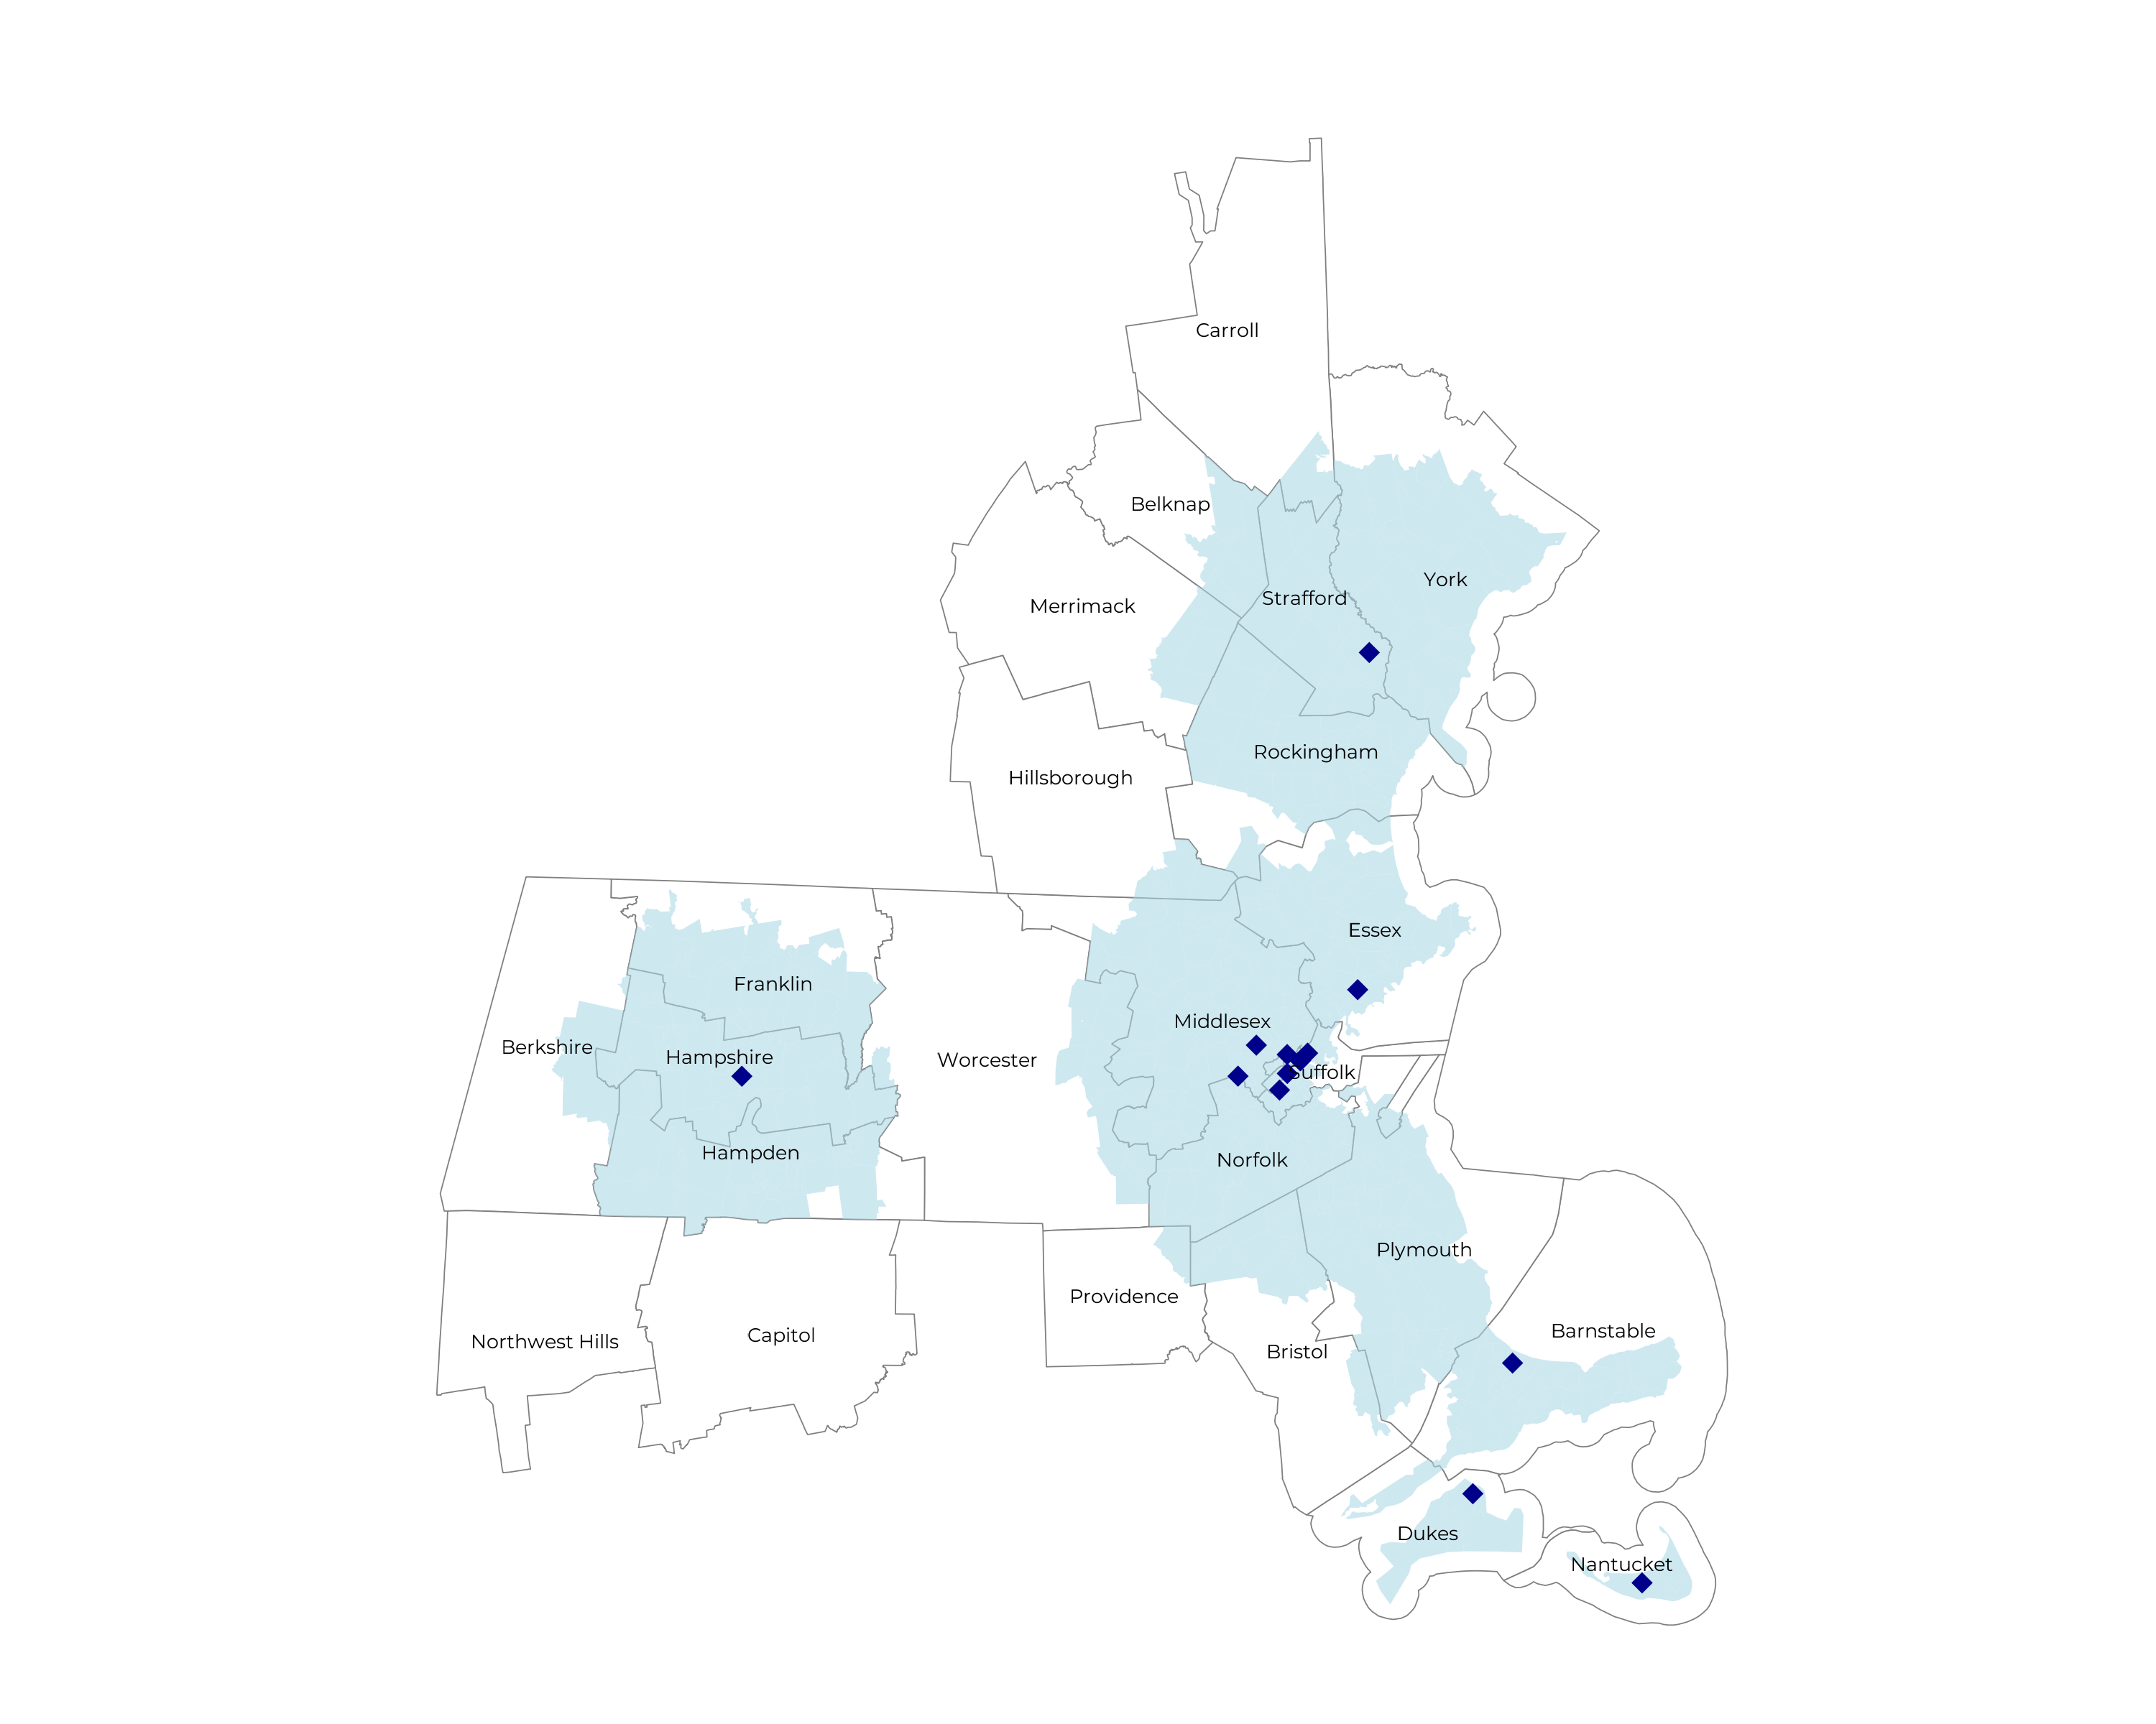
SIGNIFICANT OPPORTUNITY FOR PLAN GROWTH Researched for the below highlighted service area
Target Market 12,000+ Employers 1,600,000+ Employees 280,000+ Members
 | Employer Size Group (# of Employees)
Commercial Employers With Headquarters | 50-100 | 101-200 | 201-400 | 401-1,000 | 1,001-3,000 | 3,000+
In Catchment Area | 6,319 | 2,899 | 1,628 | 1,012 | 362 | 204
Total Employees at Employers | 50-100 | 101-200 | 201-400 | 401-1,000 | 1,001-3,000 | 3,000+
Headquartered in Catchment Area | 473,900 | 434,900 | 488,400 | 708,400 | 724,000 | 1,224,000
Total Members with Employers | 50-100 | 101-200 | 201-400 | 401-1,000 | 1,001-3,000 | 3,000+
Headquartered in Catchment Area | 853,000 | 782,800 | 879,100 | 1,275,100 | 1,303,200 | 2,203,200

Slide 9
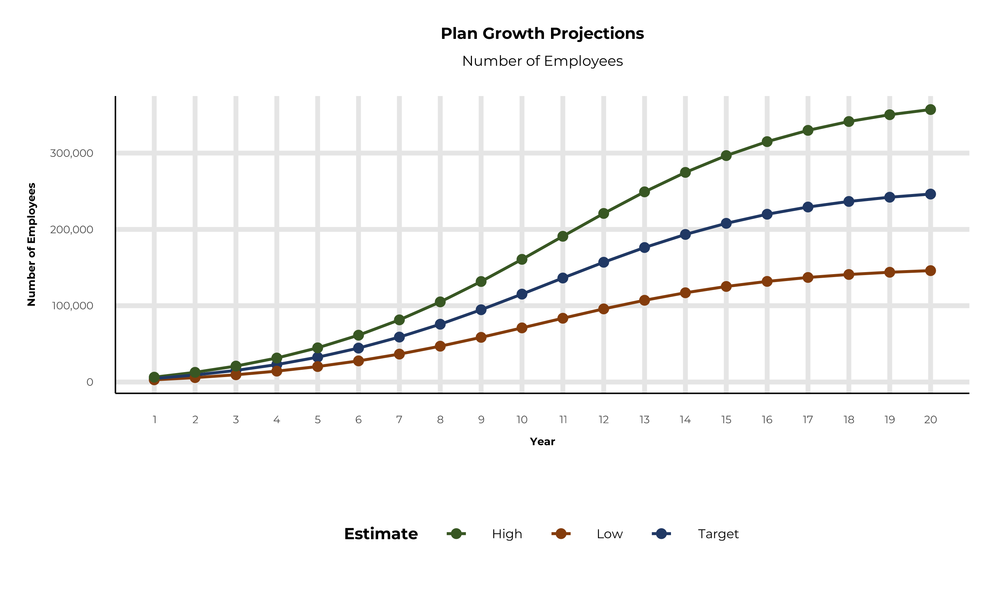
PLAN POTENTIAL GROWTH PATHS
Self Funded
1,688K
Insured
2,881K
Working Age
3,837K
Population
6,228K
Estimates includes the Mass General Brigham service area in York, Barnstable, Berkshire, Bristol, Dukes, Essex, Franklin, Hampden, Hampshire, Middlesex, Nantucket, Norfolk, Plymouth, Suffolk, Worcester, Belknap, Carroll, Hillsborough, Merrimack, Rockingham, Strafford, and Providence Counties

Slide 10
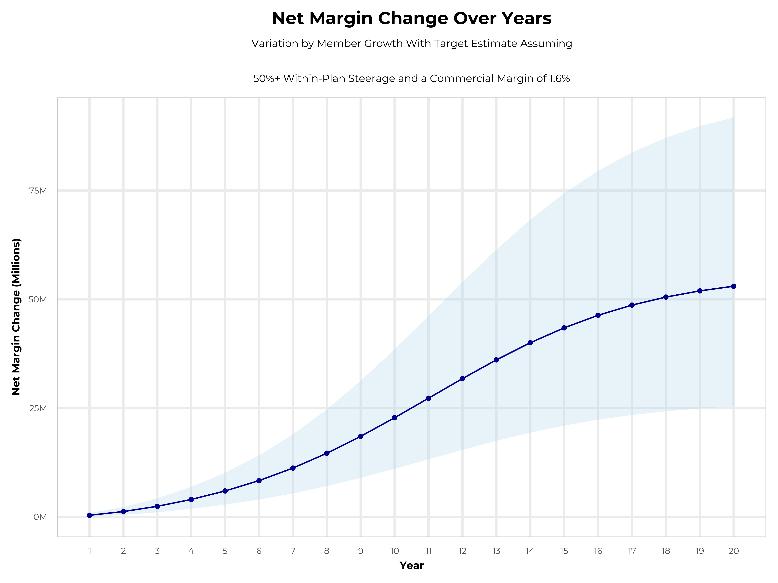
GROWING POWERFUL, LASTING PROFITABILITY
Early Stage
Gaining Name Recognition, Early Growth
New Revenue:
New Profit:
$106.52M
$3.72M
Growth Stage
Strong Reputation, Strong Growth
New Revenue:
New Profit:
$642.75M
$23.18M
Mature Stage
High Profitability, Market Saturation
New Revenue:
New Profit:
$1327.47M
$47.7M

Slide 11
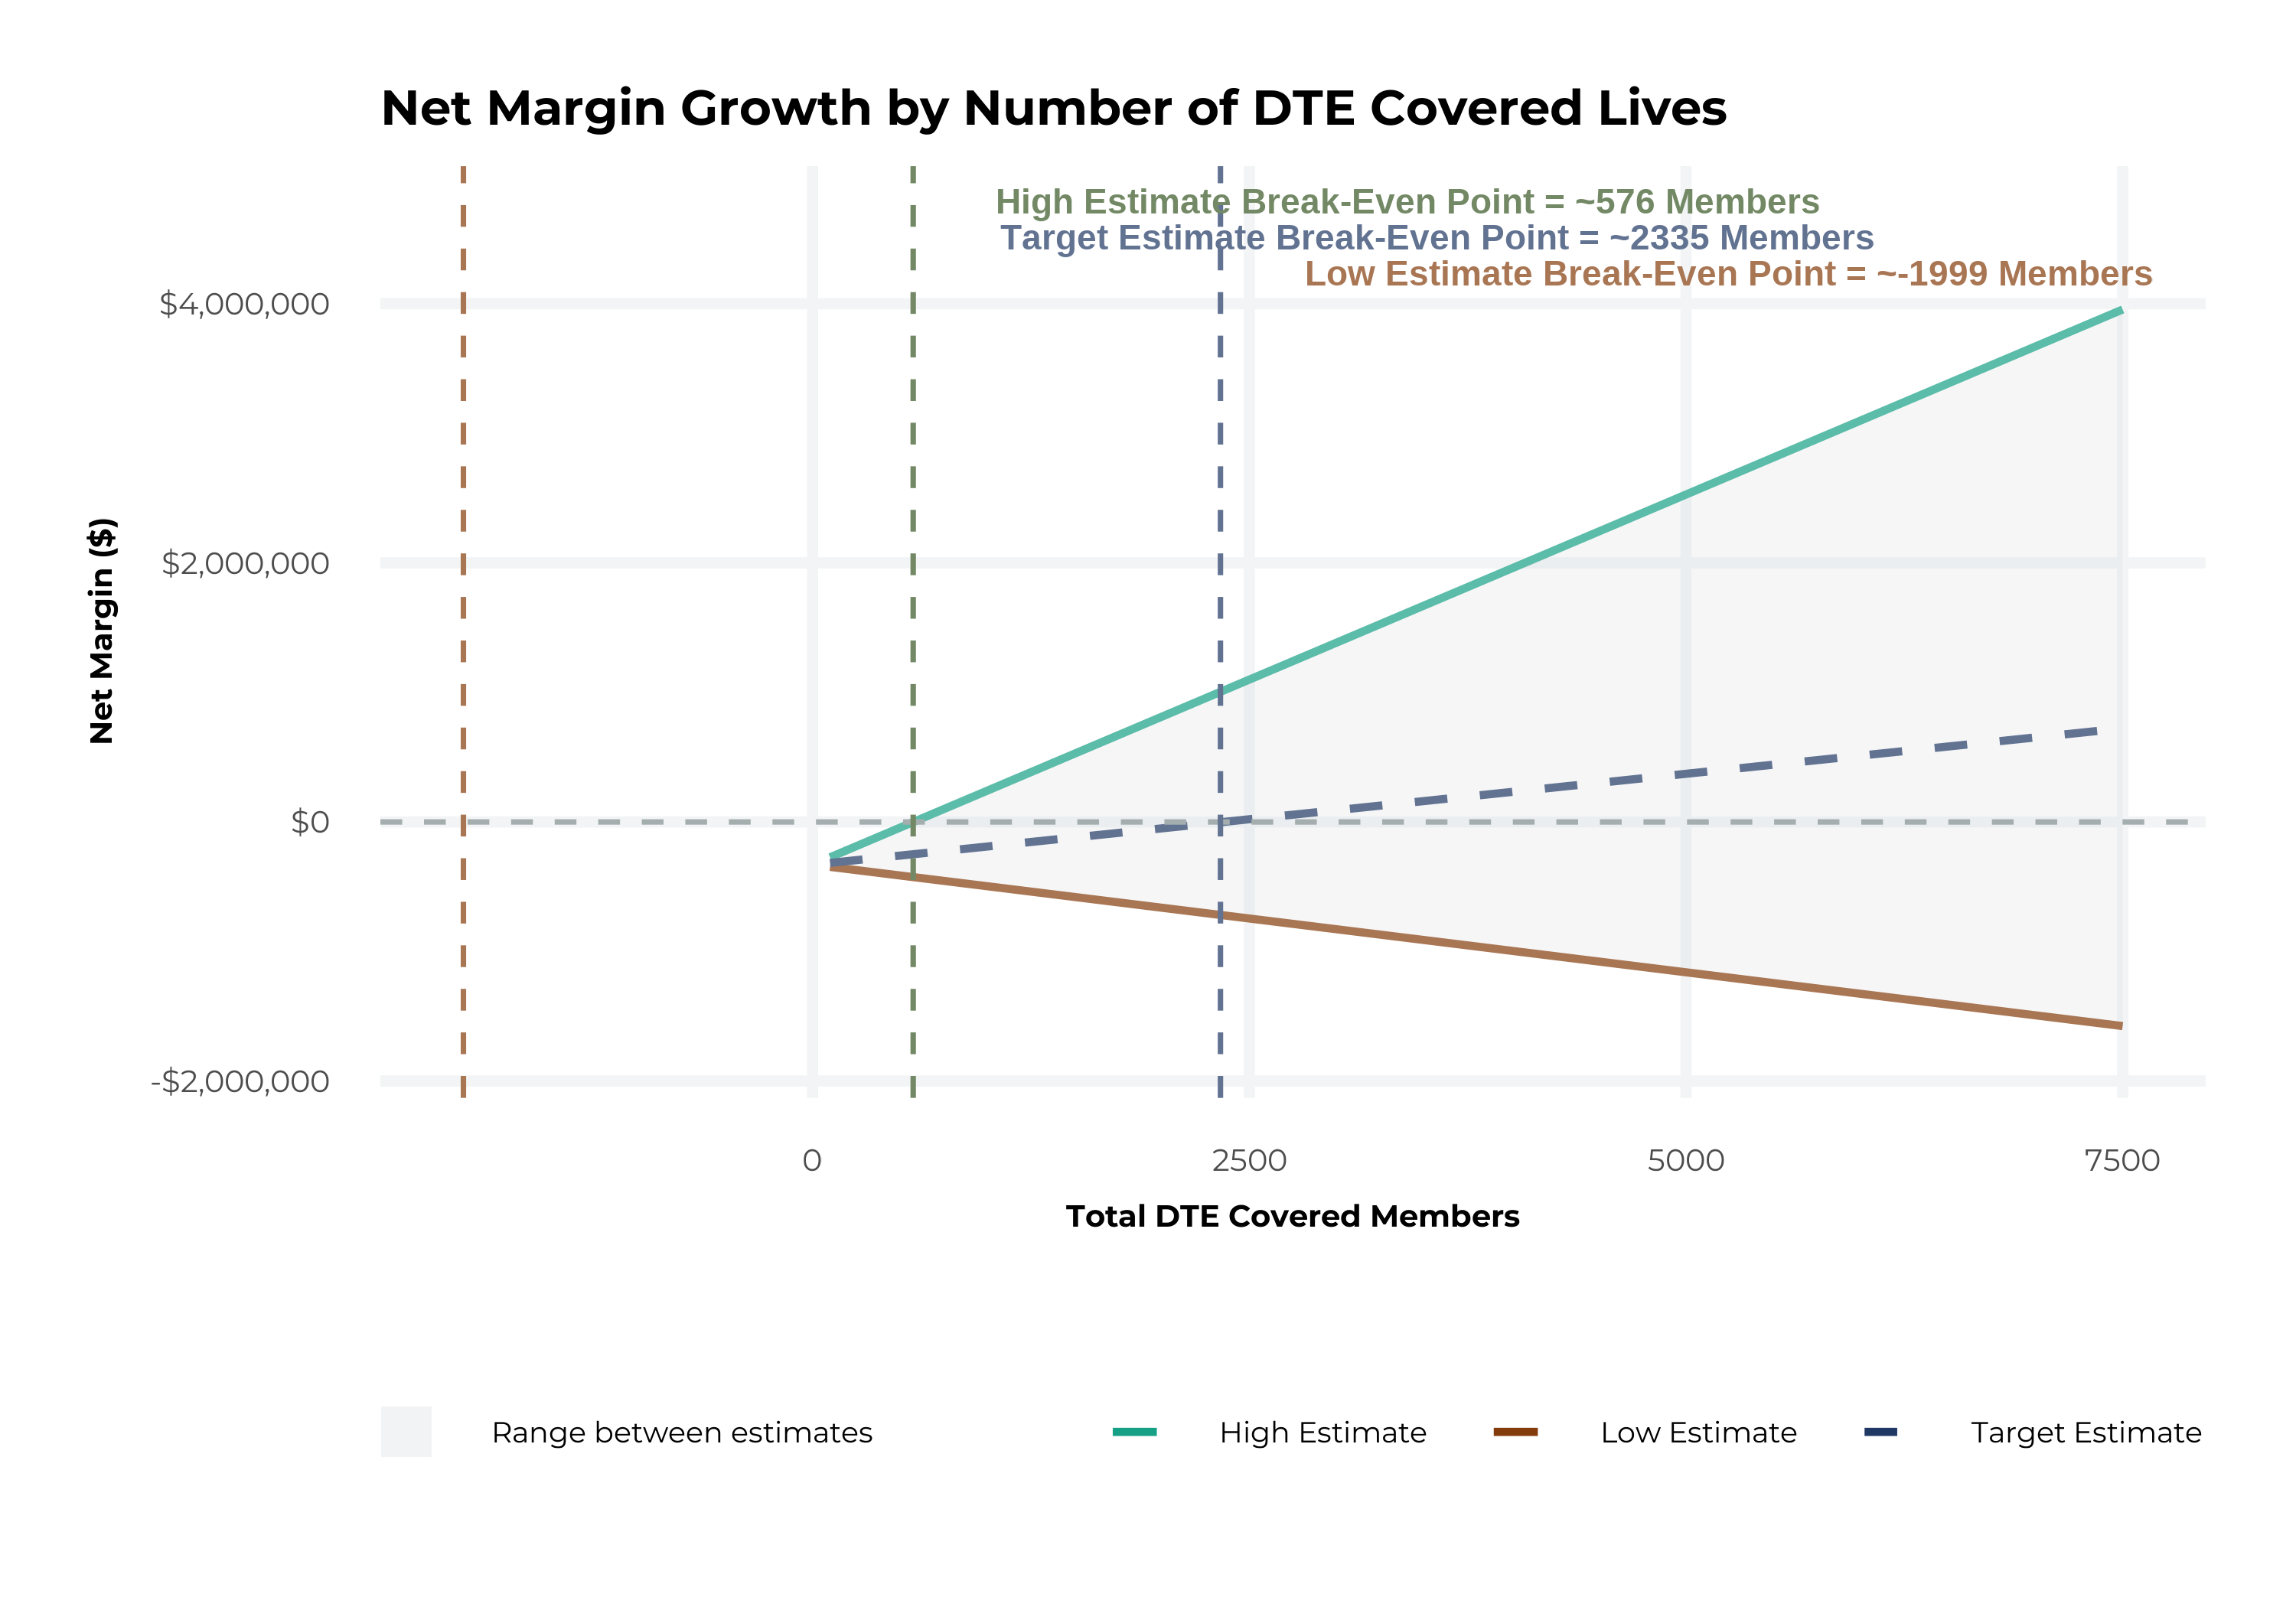
MODEL ASSUMPTIONS AND BREAK EVEN
Patient Steerage Assumptions
KBA currently estimates that Mass General Brigham has 32% inpatient market share, and 16% outpatient market compared to hospitals/clinics in the Mass General Brigham service area (see slide 8). The DTE tiered structure will create immediate steerage, with additional steerage over time from patient bonus benefits and the patient card (see slide 34 for estimates of target steerage).
Low
High
10% below target
10% above target
Commercial Margin Assumptions
KBA observes a Mass General Brigham 4% commercial margin. Conservatively, we model the DTE to be even with commercial rates given prices 10% below market, but with a 10 percentage-point increase through friendlier billing practices and improved patient collections with the patient card.
Low
Target
High
-1.8%
3.2%
8.2%

Slide 12
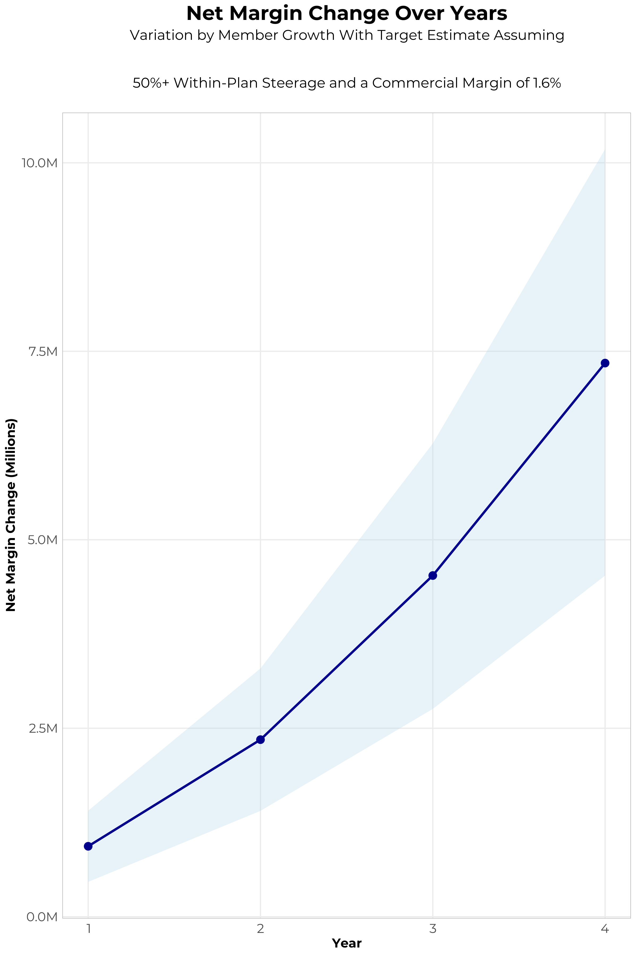
FOUR-YEAR PROJECTIONS
Target Member Growth | Target Member Growth | Target Member Growth | Target Member Growth | Target Member Growth
Metric | Year 1 | Year 2 | Year 3 | Year 4
Number of Members | 8,300 | 16,600 | 27,400 | 41,100
Incremental Margin | 1,164.8K | 2,329.7K | 4,376.8K | 7,030.2K
Network Access Fee | 99.6K | 199.2K | 328.8K | 493.2K
Implementation Fee (One-Time) | -150.0K | 0.0K | 0.0K | 0.0K
Sales and Marketing Costs | -180.0K | -180.0K | -180.0K | -180.0K
Net Margin Change | 934.4K | 2,348.9K | 4,525.6K | 7,343.4K
High Member Growth | High Member Growth | High Member Growth | High Member Growth | High Member Growth
Metric | Year 1 | Year 2 | Year 3 | Year 4
Number of Members | 11,400 | 22,800 | 37,600 | 56,600
Incremental Margin | 1,599.9K | 3,199.8K | 6,006.1K | 9,681.5K
Network Access Fee | 136.8K | 273.6K | 451.2K | 679.2K
Implementation Fee (One-Time) | -150.0K | 0.0K | 0.0K | 0.0K
Sales and Marketing Costs | -180.0K | -180.0K | -180.0K | -180.0K
Net Margin Change | 1,406.7K | 3,293.4K | 6,277.3K | 10,180.7K
Low Member Growth | Low Member Growth | Low Member Growth | Low Member Growth | Low Member Growth
Metric | Year 1 | Year 2 | Year 3 | Year 4
Number of Members | 5,200 | 10,400 | 17,100 | 25,700
Incremental Margin | 729.8K | 1,459.5K | 2,731.5K | 4,396.0K
Network Access Fee | 62.4K | 124.8K | 205.2K | 308.4K
Implementation Fee (One-Time) | -150.0K | 0.0K | 0.0K | 0.0K
Sales and Marketing Costs | -180.0K | -180.0K | -180.0K | -180.0K
Net Margin Change | 462.2K | 1,404.3K | 2,756.7K | 4,524.4K

Slide 13
DIRECT-TO-EMPLOYER STRATEGY: ONLY AVAILABLE TO PREMIER HEALTH SYSTEMS
STRONG Brand Quality
EXTENSIVE Patient Access
AFFORDABLE Value Pricing
EXCELLENT Care Quality

Slide 14
Health System | HCAHPS Recommendation Percentile | CMS Stars Percentile | Mortality Percentile | Readmission Percentile | KBA Brand Quality Score
Mass General Brigham | 83 | 98 | 72 | 65 | 72
Catholic Medical Center | 78 | 87 | 73 | 66 | 72
Lifespan | 68 | 100 | 80 | 69 | 68
Boston Medical Center Corporation | 61 | 60 | 75 | 56 | 67
Capital Region Health Care | 58 | 60 | 71 | 64 | 67
Beth Israel Lahey Health | 61 | 87 | 68 | 60 | 65
Covenant Health (MA) | 54 | 87 | 74 | 81 | 64
SolutionHealth | 48 | 60 | 69 | 59 | 63
Trinity Health | 47 | 60 | 66 | 53 | 63
Holyoke Medical Center | 46 | 31 | 56 | 53 | 62
Other Independent Hospitals | 48 | 56 | 63 | 59 | 61
South Shore Health | 46 | 87 | 50 | 55 | 61
Cambridge Health Alliance | 40 | 60 | 62 | 71 | 60
UMass Memorial Health Care | 42 | 77 | 65 | 53 | 59
Tufts Medicine | 39 | 56 | 65 | 46 | 59
Cape Cod Healthcare | 40 | 67 | 75 | 51 | 59
Baystate Health | 31 | 23 | 65 | 48 | 55
HCA Healthcare | 27 | 63 | 73 | 58 | 54
MaineHealth | 21 | 60 | 62 | 82 | 51
Prime Healthcare Services | 12 | 60 | 71 | 49 | 49
Steward Health Care System | 12 | 28 | 73 | 50 | 48
Tenet Healthcare | 6 | 31 | 63 | 60 | 46
Mass General Brigham is the most recommended health system in York, Barnstable, Berkshire, Bristol, Dukes, Essex, Franklin, Hampden, Hampshire, Middlesex, Nantucket, Norfolk, Plymouth, Suffolk, Worcester, Belknap, Carroll, Hillsborough, Merrimack, Rockingham, Strafford, and Providence Counties.

Slide 15
Out of Network
Friends & Family (Contracted)
Wrap Network (Rented)
Mass General Brigham’s Network
The medical providers in your direct control or part of Mass General Brigham’s integrated delivery system
Potential risk sharing arrangements (e.g. employer stop-loss participation)
Friends & Family Providers – TIER 1
Access through direct contracts at the discretion of Mass General Brigham
WRAP NETWORK
Medical services from national PPO networks for members that travel, tertiary and specialty services you do not provide, and employees residing outside your direct catchment area
OUT-OF-NETWORK
Non-contracted medical providers

Slide 16
SINGLE YEAR SUMMARY
DTE Covered Members Financial Analysis | DTE Covered Members Financial Analysis | DTE Covered Members Financial Analysis | DTE Covered Members Financial Analysis | DTE Covered Members Financial Analysis | DTE Covered Members Financial Analysis | DTE Covered Members Financial Analysis | DTE Covered Members Financial Analysis
Target Estimate Assuming 50%+ Within-Plan Steerage and a Commercial Margin of 1.6%. | Target Estimate Assuming 50%+ Within-Plan Steerage and a Commercial Margin of 1.6%. | Target Estimate Assuming 50%+ Within-Plan Steerage and a Commercial Margin of 1.6%. | Target Estimate Assuming 50%+ Within-Plan Steerage and a Commercial Margin of 1.6%. | Target Estimate Assuming 50%+ Within-Plan Steerage and a Commercial Margin of 1.6%. | Target Estimate Assuming 50%+ Within-Plan Steerage and a Commercial Margin of 1.6%. | Target Estimate Assuming 50%+ Within-Plan Steerage and a Commercial Margin of 1.6%. | Target Estimate Assuming 50%+ Within-Plan Steerage and a Commercial Margin of 1.6%.
DTE Members | Pre-DTE Revenue | Pre-DTE Margin | DTE Revenue | DTE Incr. Revenue | DTE Total Margin | DTE Incr. Margin | Net Margin Less DTE Fees
100 | $ 257K | $ 8K | $ 658K | $ 401K | $ 21K | $ 13K | $ -316K
500 | $ 1,283K | $ 41K | $ 3,288K | $ 2,005K | $ 105K | $ 64K | $ -260K
1,000 | $ 2,566K | $ 82K | $ 6,577K | $ 4,011K | $ 210K | $ 128K | $ -190K
2,500 | $ 6,415K | $ 205K | $ 16,441K | $10,027K | $ 526K | $ 321K | $ 21K
10,000 | $25,659K | $ 821K | $ 65,765K | $40,107K | $2,104K | $1,283K | $1,073K
20,000 | $51,317K | $1,642K | $131,531K | $80,213K | $4,209K | $2,567K | $2,477K
NOTE: Please see detailed financial analysis and assumptions used starting on page 23.
Financial projections do not include 340B contribution margin, which could represent $136 PMPM by optimizing 340B through Rx plan design, Mass General Brigham’s approved site(s) with network integration, and development of Mass General Brigham’s proprietary PBM program.

Slide 17


INTEGRATION WITH EPIC EHR SYSTEM
KBA shares
evidence-based standards of care for 27 chronic conditions directly into Epic
Hyperthyroidism: Yearly Clinical Evaluation, TSH and T4

Slide 18

THE MISSING PIECE TO VALUE-BASED CARE
Patient engagement is the weak link in delivering value-based care; Mass General Brigham’s clinical leadership and employer participation can drive better outcomes.
KBA’s proactive care-management team supplements your care-management efforts in outreach to clients.
Mass General Brigham excels in Standards of Care completion rates for the Chronically Ill, improving care and costs.
Integrating Mass General Brigham’s managed care with KBA’s programs positions Mass General Brigham as the value leader.

Slide 19

TRANSPARENT PBM INTEGRATION
Support of Mass General Brigham’s retail pharmacy(s)
Optimize Mass General Brigham’s 340B drug
pricing program
Allows Mass General Brigham to create its own PBM program if desired
Custom telephone number with personalized scripting and separate call tracking & reporting
Fully customizable member welcome booklet & materials
White labeled formulary document and marketing materials
CUSTOM CLIENT SUPPORT:
Specialized call center capabilities
Fully customizable plan designs
Operational access to the platform
Customized process and functions to promote DTE strategy
CLINICAL FLEXIBILITY:
Full portfolio of custom formulary offerings – with optimized formulary shield
Clinical programs that drive towards overall DTE strategy
Options for additional drug savings by driving members to lower cost alternatives
Flexibility to customize or layer on utilization management programs

Slide 20
STOP-LOSS INSURANCE THE KBA EXPERIENCE
Tokio Marine
Nationwide
Berkshire Hathaway
Sun Life
Liberty Mutual
Granular (Google)
Companion Life
Crum & Forster
American Fidelity
RGA
Deep relationships with 20+ stop loss underwriters and carriers
Over $150M in annual stop loss premium placement
Comprehensive pricing and medical service analysis performed for each DTE health plan to ensure proper pricing
KBA provides the administration required of the stop-loss markets:
Bordereau Reporting
Claim Reporting and Reconciliation
Evaluation of Networks
Care Management
Initial Underwriting
Negotiation of rates and terms
Plan Design Actuarial

Slide 21

DTE PROGRAM MARKETING & SALES
KBA WORKS WITH YOU TO MANAGE & SELL:
Branding & Messaging
Direct & Brokerage Sales Distribution – Focused Sales Representative
Brochures, Web Site, Media, etc.
Stop-Loss/Level Funded Down to 20 EE Lives
Sell Through Established Brokers in Your Service Area

Slide 22

COMMUNITY BASED SALES STRATEGY
Locally based sales rep with strong community ties
Collaboration with DTE provider partners to identify strategic employers for early adoption and sales
Work with select broker distribution partners with aligned incentives and goals
Pipeline reporting and collaboration with our DTE provider partners
Marketing and promotion of the new option in the community

Slide 23


Complete Marketing System
Customized Branding and Messaging
Customized Brochures
Customized Web Site
Targeted Employer Outreach
Sales System (Social Media, Email, Text, etc.)

Slide 24

THE KBA HEALTHCARE CREDIT CARD
Creating EPO Steerage in a PPO Network
The Healthcare Credit Card is eligible to be used only for specific merchant codes.
To utilize at Specific Healthcare Providers
a. Designated Hospitals
b. Urgent Care Facilities
c. Physicians
d. Eligible Ancillary Providers
Out of Pocket Expenses Qualify
0% Interest Rate
Employee Determines Repayment Schedules
5. To Qualify: Answer One Simple Question
Notes:
Replace with slide 1 of updates provided by Jan, but update design to match the rest of ppt

Slide 25
KEY INCENTIVE PLAN (KIP):
BASE MEDICAL + BONUS BENEFITS = YOUR DEDUCTIBLE CAN SIMPLY VANISH
BENEFIT EXAMPLE |  |  |  |  | CLAIM EXAMPLE
BASE MEDICAL BENEFITS |  | BONUS BENEFITS |  |  | “How Your Deductible Can Vanish”
Deductible |  | Benefits Automatically Included In Your Plan, At NO Additional Cost To You! |  |  | CLAIM EXAMPLE: Heart Attack, with Surgery
Single | $2,500 | Preferred Hospital Stay | 5 Days at $500 / Day |  | OP Radiology/X-Ray | $200
Family | $3,500 | Non-Preferred Hospital Stay | 1 Day at $50 / Day |  | OP Diagnostic Labs | $100
Coinsurance | 80% / 20% | OP Surgery | $700 / 1 Day |  | Preferred Hospital Stay, 5 Days at $500/Day | $2,500
Maximum Out-of-Pocket |  | OP Anesthesia | $250 / 1 Day |  | Critical Illness (Heart Attack Benefit) | $2,000
Single | $3,500 | OP Radiology/X-Ray | $200 / 1 Day |  | Health Screening Benefit (Stress-Test) | $125
Family | $7,000 | OP Diagnostic Labs | $100 / 1 Day |  | Wellness Benefit (Telephonic Coaching) | $125
Chronic Disease Management Regimens of Care, Covered at 100% |  | Health Screening Benefit | $125 / 1 Day |  | TOTAL BONUS BENEFIT PAYABLE | $5,050
Healthcare Specific, Interest Free Credit Card to Cover Out-of-Pocket Costs |  | Wellness Benefit | $125/1 Day |  | Less Your Maximum Out-of-Pocket Cost | ($3,500)
 |  | Critical Illness Benefit* | $2,000 Lump Sum |  | Additional Benefit, Payable Directly to You! | $1,550!
 |  | *Critical Illness Benefits pays for 1st Diagnosis: Heart Attack, Stroke, Internal Cancer
Notes:
Replace with slide 2 of updated ppt provided by Jan, but update to match rest of ppt

Slide 26


THE BENEFIT STEERING THE PATIENT TO Mass General Brigham
What Will this Claim Cost Me?
Mass General Brigham patients will often receive cash, not bills after care episodes!
Notes:
Make necessary changes to match slide 4 of updated ppt provided by Jan

Slide 27

FINANCIAL PROJECTIONS
& ASSUPTIONS

Slide 28
ESTIMATION OF MASS GENERAL BRIGHAM’S 2022 PAYER MIX
Payer Group | Total Inpatient Days | Revenue | Payer Mix
All Mass General Brigham | 1,008,964 | $10,168,770K | 100%
Medicare | 351,444 | $2,086,219K | 35%
Medicaid | 84,089 | $729,243K | 8%
Other Government Pay | 0
No-Pay, Charity Care | 52,881 | -$603,149K | 6%
Commercial/Self Pay | 520,550 | $7,356,957K | 51%
Estimating Payer Mix
Medicare, Medicaid, and other government payer mixes are estimated as the percentage of inpatient days for each group divided by total inpatient days.
No-pay and charity care is estimated as the percentage of no-pay/charity care compared to total overall revenue.
Commercial/self pay is assumed to be the rest of the total payer mix share.
Estimating Total Inpatient Days
Total inpatient days for ‘No Pay’ and ‘Commercial’ are estimated to be the payer mix estimates for “No Pay, Charity Care” and “Commercial/Self Pay” multiplied by the total number of inpatient days.
Values in blue are taken from the 2021 Medicare Provider Cost Report (https://data.cms.gov/provider-compliance/cost-report/hospital-provider-cost-report/data)
In other analysis, the outpatient payer mix is assumed to mirror the inpatient payer mix.
Values in yellow are taken from Definitive Healthcare data.
Total Medicare patient revenue is reported by CMS in the Medicare Provider Analysis and Review Report (MedPAR)

Slide 29
ESTIMATION OF MARGIN FOR COMMERCIAL VS. GOVERNMENT PAY
The RAND data for Mass General Brigham estimates commercial insurance reimbursements at 222% of Medicare Rates
Estimating Commercial Margin
(Calculated through counterfactual of assuming all CMS/Government pay was paying at commercial rates)
Estimating Gov-Pay Margin
(Calculated through counterfactual of assuming all commercial pay was paying at Medicare rate)
Commercial Revenue | $7,356,957K
Gov-pay revenue at 222% current rate | $6,258,455K
Total Revenue | $13,615,413K
Total Costs | $13,123,503K
Net Income | $491,909K
 | 4%
Commercial Revenue Divided by 222% | $3,309,641K
Gov-pay revenue | $2,815,462K
Total Revenue | $6,125,103K
Total Costs | $13,123,503K
Net Income | $ -6,998,400K
 | -114%

Slide 30
ESTIMATING MARKET SHARE
Hospital Name | Number of Beds | Inpatient Total Charges | Outpatient Total Charges | Inpatient Percent of Market Total | Outpatient Percent of Market Total (Assuming 56.1% of Physicians Employed by Hospitals)
Cooley Dickinson Hospital | 118 | $ 167,344.3K | $ 552,014.5K | <1% | <1%
Salem Hospital | 268 | $ 746,051.3K | $1,132,858.0K | 2% | 1%
Massachusetts General Hospital | 997 | $5,726,296.1K | $7,293,701.6K | 13% | 6%
Massachusetts Eye and Ear | 41 | $ 56,591.5K | $ 581,269.8K | <1% | 1%
Newton-Wellesley Hospital | 216 | $ 696,508.7K | $1,372,248.6K | 2% | 1%
Brigham and Womens Hospital | 826 | $5,347,275.2K | $4,489,441.7K | 12% | 4%
Brigham and Womens Faulkner Hospital | 147 | $ 343,530.8K | $ 779,667.1K | 1% | 1%
Nantucket Cottage Hospital | 14 | $ 12,488.3K | $ 121,269.6K | <1% | <1%
Marthas Vineyard Hospital | 25 | $ 26,379.1K | $ 232,435.2K | <1% | <1%
Spaulding Hospital for Continuing Medical Care Cambridge | 180 | $ 159,641.8K | $ 15,255.2K | <1% | <1%
Spaulding Rehabilitation Hospital Cape Cod | 60 | $ 50,495.4K | $ 63,483.0K | <1% | <1%
Spaulding Rehabilitation Hospital Boston | 132 | $ 184,772.4K | $ 210,205.6K | <1% | <1%
McLean Hospital | 218 | $ 286,591.9K | $ 140,495.3K | 1% | <1%
Wentworth-Douglass Hospital | 118 | $ 381,766.5K | $1,574,784.7K | 1% | 1%
32% Inpatient Market Share
16% Outpatient Market Share
For outpatient market share, it is estimated that only 56.1% of local physicians are employed by area hospitals (Research from the Physician Advocacy Institute: https://www.physiciansadvocacyinstitute.org/Portals/0/assets/docs/PAI-Research/PAI-Avalere%20Physician%20Employment%20Trends%20Study%202019-2023%20Final.pdf?ver=uGHF46u1GSeZgYXMKFyYvw%3d%3d)

Slide 31
Hospital Metrics | Hospital Metrics | Hospital Metrics | Hospital Metrics | Hospital Metrics | Hospital Metrics | Hospital Metrics | Hospital Metrics | Hospital Metrics | Hospital Metrics | Hospital Metrics | Hospital Metrics | Hospital Metrics | Hospital Metrics
Metric | Cooley Dickinson Hospital | Salem Hospital | Massachusetts General Hospital | Massachusetts Eye and Ear | Newton-Wellesley Hospital | Brigham and Women's Hospital | Brigham and Women's Faulkner Hospital | Nantucket Cottage Hospital | Marthas Vineyard Hospital | Spaulding Rehabilitation Hospital Cape Cod | Spaulding Rehabilitation Hospital Boston | McLean Hospital | Wentworth-Douglass Hospital
Total Inpatient Patient Revenue | $58,403K | $219,339K | $1,706,436K | $25,693K | $233,330K | $1,604,183K | $105,807K | $7,231K | $13,744K | $22,470K | $78,343K | $151,321K | $107,276K
Total Outpatient Patient Revenue | $192,653K | $333,060K | $2,173,523K | $263,896K | $459,703K | $1,346,833K | $240,137K | $70,215K | $121,099K | $28,250K | $89,127K | $74,182K | $442,514K
Total Medicare Revenue | $57,321K | $123,032K | $833,875K | $61,411K | $144,085K | $600,069K | $85,001K | $7,698K | $23,344K | $21,791K | $35,458K | $17,652K | $75,481K
Estimated Medicaid and Other Government-Pay Revenue | $21,520K | $81,691K | $299,883K | $23,998K | $32,932K | $192,301K | $32,591K | $4,284K | $0K | $0K | $0K | $0K | $40,043K
Estimated Commercial Revenue | $172,144K | $347,775K | $2,745,761K | $203,909K | $514,799K | $2,163,444K | $228,534K | $65,418K | $111,504K | $28,886K | $132,058K | $207,948K | $434,777K
Total Uncompensated Care | $12,066K | $59,007K | $263,411K | $7,825K | $37,856K | $176,341K | $26,132K | $9,568K | $1,166K | $0K | $0K | $0K | $9,776K
Estimated Inpatient Costs | $56,692K | $242,920K | $2,425,079K | $35,557K | $237,931K | $2,152,025K | $114,759K | $8,327K | $13,603K | $24,753K | $97,330K | $239,204K | $91,611K
Estimated Outpatient Costs | $187,007K | $368,867K | $3,088,874K | $365,221K | $468,767K | $1,806,788K | $260,454K | $80,865K | $119,863K | $31,120K | $110,727K | $117,264K | $377,895K
Total Operating Expenses | $243,699K | $611,786K | $5,513,953K | $400,778K | $706,699K | $3,958,813K | $375,213K | $89,192K | $133,466K | $55,874K | $208,057K | $356,468K | $469,506K
Net Income | $7,287K | $-59,288K | $-1,634,434K | $-111,460K | $-14,883K | $-1,002,999K | $-29,088K | $-11,792K | $1,383K | $-5,197K | $-40,541K | $-130,868K | $80,795K
Estimated Commercial Profit Margin | 29.9% | 23.8% | -4.7% | -1.8% | 22.2% | -0.9% | 23.4% | 3.1% | 18.3% | 27.7% | 1.3% | -44.2% | 32.1%
1. Most data is taken from the CMS provider cost report | 1. Most data is taken from the CMS provider cost report | 1. Most data is taken from the CMS provider cost report | 1. Most data is taken from the CMS provider cost report | 1. Most data is taken from the CMS provider cost report | 1. Most data is taken from the CMS provider cost report | 1. Most data is taken from the CMS provider cost report | 1. Most data is taken from the CMS provider cost report | 1. Most data is taken from the CMS provider cost report | 1. Most data is taken from the CMS provider cost report | 1. Most data is taken from the CMS provider cost report | 1. Most data is taken from the CMS provider cost report | 1. Most data is taken from the CMS provider cost report | 1. Most data is taken from the CMS provider cost report
2. Medicare costs are taken from the Medicare Provider Analysis and Review (MedPAR) | 2. Medicare costs are taken from the Medicare Provider Analysis and Review (MedPAR) | 2. Medicare costs are taken from the Medicare Provider Analysis and Review (MedPAR) | 2. Medicare costs are taken from the Medicare Provider Analysis and Review (MedPAR) | 2. Medicare costs are taken from the Medicare Provider Analysis and Review (MedPAR) | 2. Medicare costs are taken from the Medicare Provider Analysis and Review (MedPAR) | 2. Medicare costs are taken from the Medicare Provider Analysis and Review (MedPAR) | 2. Medicare costs are taken from the Medicare Provider Analysis and Review (MedPAR) | 2. Medicare costs are taken from the Medicare Provider Analysis and Review (MedPAR) | 2. Medicare costs are taken from the Medicare Provider Analysis and Review (MedPAR) | 2. Medicare costs are taken from the Medicare Provider Analysis and Review (MedPAR) | 2. Medicare costs are taken from the Medicare Provider Analysis and Review (MedPAR) | 2. Medicare costs are taken from the Medicare Provider Analysis and Review (MedPAR) | 2. Medicare costs are taken from the Medicare Provider Analysis and Review (MedPAR)
3. Data with 'Estimated' in the title are derived from other data points. | 3. Data with 'Estimated' in the title are derived from other data points. | 3. Data with 'Estimated' in the title are derived from other data points. | 3. Data with 'Estimated' in the title are derived from other data points. | 3. Data with 'Estimated' in the title are derived from other data points. | 3. Data with 'Estimated' in the title are derived from other data points. | 3. Data with 'Estimated' in the title are derived from other data points. | 3. Data with 'Estimated' in the title are derived from other data points. | 3. Data with 'Estimated' in the title are derived from other data points. | 3. Data with 'Estimated' in the title are derived from other data points. | 3. Data with 'Estimated' in the title are derived from other data points. | 3. Data with 'Estimated' in the title are derived from other data points. | 3. Data with 'Estimated' in the title are derived from other data points. | 3. Data with 'Estimated' in the title are derived from other data points.
4. Market Share estimates based on total patient revenues with area hospitals. Ambulatory market share based on regional estimates of the percentage of local physicians employed by area hospitals. See Physician Advocacy Institute | 4. Market Share estimates based on total patient revenues with area hospitals. Ambulatory market share based on regional estimates of the percentage of local physicians employed by area hospitals. See Physician Advocacy Institute | 4. Market Share estimates based on total patient revenues with area hospitals. Ambulatory market share based on regional estimates of the percentage of local physicians employed by area hospitals. See Physician Advocacy Institute | 4. Market Share estimates based on total patient revenues with area hospitals. Ambulatory market share based on regional estimates of the percentage of local physicians employed by area hospitals. See Physician Advocacy Institute | 4. Market Share estimates based on total patient revenues with area hospitals. Ambulatory market share based on regional estimates of the percentage of local physicians employed by area hospitals. See Physician Advocacy Institute | 4. Market Share estimates based on total patient revenues with area hospitals. Ambulatory market share based on regional estimates of the percentage of local physicians employed by area hospitals. See Physician Advocacy Institute | 4. Market Share estimates based on total patient revenues with area hospitals. Ambulatory market share based on regional estimates of the percentage of local physicians employed by area hospitals. See Physician Advocacy Institute | 4. Market Share estimates based on total patient revenues with area hospitals. Ambulatory market share based on regional estimates of the percentage of local physicians employed by area hospitals. See Physician Advocacy Institute | 4. Market Share estimates based on total patient revenues with area hospitals. Ambulatory market share based on regional estimates of the percentage of local physicians employed by area hospitals. See Physician Advocacy Institute | 4. Market Share estimates based on total patient revenues with area hospitals. Ambulatory market share based on regional estimates of the percentage of local physicians employed by area hospitals. See Physician Advocacy Institute | 4. Market Share estimates based on total patient revenues with area hospitals. Ambulatory market share based on regional estimates of the percentage of local physicians employed by area hospitals. See Physician Advocacy Institute | 4. Market Share estimates based on total patient revenues with area hospitals. Ambulatory market share based on regional estimates of the percentage of local physicians employed by area hospitals. See Physician Advocacy Institute | 4. Market Share estimates based on total patient revenues with area hospitals. Ambulatory market share based on regional estimates of the percentage of local physicians employed by area hospitals. See Physician Advocacy Institute | 4. Market Share estimates based on total patient revenues with area hospitals. Ambulatory market share based on regional estimates of the percentage of local physicians employed by area hospitals. See Physician Advocacy Institute
Spaulding Hospital for Continuing Medical Care Cambridge not included due to limited data

Slide 32

STEERAGE RATES FOR CURRENT DTE NETWORKS
The average Tier 1 Steerage is 83%.
* Data collected from KBA DTE Networks in Q1 2024

Slide 33
PROJECTED PLAN GROWTH
Year | Employees | Members | Percent of Members Choosing Mass General Brigham for Inpatient Care | Percent of Members Choosing Mass General Brigham for Outpatient Care
1 | 4,600 | 8,300 | 60% | 50%
2 | 9,200 | 16,600 | 60% | 50%
3 | 15,200 | 27,400 | 65% | 55%
4 | 22,900 | 41,200 | 67% | 58%
5 | 32,500 | 58,500 | 68% | 60%
6 | 44,500 | 80,100 | 68% | 60%
7 | 58,900 | 106,000 | 69% | 61%
8 | 75,700 | 136,300 | 69% | 62%
9 | 94,700 | 170,500 | 69% | 62%
10 | 115,200 | 207,400 | 70% | 63%
11 | 136,300 | 245,300 | 70% | 63%
12 | 157,000 | 282,600 | 70% | 64%
13 | 176,300 | 317,300 | 71% | 64%
14 | 193,400 | 348,100 | 71% | 65%
15 | 208,000 | 374,400 | 71% | 66%
16 | 219,900 | 395,800 | 72% | 66%
17 | 229,300 | 412,700 | 72% | 66%
18 | 236,600 | 425,900 | 72% | 67%
19 | 242,200 | 436,000 | 72% | 67%
20 | 246,300 | 443,300 | 72% | 67%
KBA currently estimates that Mass General Brigham has 32% inpatient market share, and 16% outpatient market compared to hospitals/clinics in the Mass General Brigham service area (see slide 8).
Based on previous DTE experience, KBA expects a significant bump in patient steerage to Mass General Brigham.
Additional steerage will occur from additional steerage patient benefits and the patient card.
High estimates start nearly 10% higher than target with low estimates at 10% lower than target

Slide 34
YEAR 4 PROJECTED REVENUE AND PROFIT
Pre-DTE Cohort of 41,100 Employees | Inpatient | Outpatient | Professional | Total
Revenue† | $ 45,113,287 | $ 41,134,335 | $ 19,209,385 | $ 105,457,007
Net Income‡ | $ 1,443,625 | $ 1,316,299 | $ 614,700.3 | $ 3,374,624
† Assuming proportional revenues from market shares of 32% (inpatient) and 16% (outpatient)
‡ Conservatively assuming a commercial margin of 3.2% (80% of the estimated commercial margin)
With DTE | Inpatient | Outpatient | Professional | Total
Revenue⁰ | $ 93,845,190 | $ 147,167,265 | $ 68,725,861 | $ 309,738,316
Net Income* | $ 3,003,046 | $ 4,709,352 | $ 2,199,228 | $ 9,911,626
⁰ Assuming 67% inpatient and 58% market steerage based on KBA narrow network DTE experience (see previous slide)
* Conservatively assuming a commercial margin of 3.2%, with a 10 percentage-point reduction to reflect competitive-edge rates and a 10 percentage-point increase due to lower billing costs and higher patient responsibility collections because of the member credit card.
Total Increase in Net Income | $ 6,537,002
Network Access Fee (Revenue) of $1 PMPM | $ 493,200
Total Profit Growth | $ 6,541,802
Minus Implementation Fee (One-Time) | -$ 0
Minus Sales and Marketing (Annual – Ongoing) | -$ 180,000
Total | $ 6,850,202

Slide 35
Target Estimate Assuming 50%+ Within-Plan Steerage and a Commercial Margin of 1.6% | Target Estimate Assuming 50%+ Within-Plan Steerage and a Commercial Margin of 1.6% | Target Estimate Assuming 50%+ Within-Plan Steerage and a Commercial Margin of 1.6% | Target Estimate Assuming 50%+ Within-Plan Steerage and a Commercial Margin of 1.6% | Target Estimate Assuming 50%+ Within-Plan Steerage and a Commercial Margin of 1.6%
All values in thousands of dollars. Modeled With Year 1 Fees and Patient Steerage. | All values in thousands of dollars. Modeled With Year 1 Fees and Patient Steerage. | All values in thousands of dollars. Modeled With Year 1 Fees and Patient Steerage. | All values in thousands of dollars. Modeled With Year 1 Fees and Patient Steerage. | All values in thousands of dollars. Modeled With Year 1 Fees and Patient Steerage.
Metric | 500 DTE Covered Lives | 1000 DTE Covered Lives | 5000 DTE Covered Lives | 25000 DTE Covered Lives
Pre-DTE Group Inpatient Revenue | $548.8 | $1,097.6 | $5,488.2 | $27,441.2
Pre-DTE Group Inpatient Margin | $17.6 | $35.1 | $175.6 | $878.1
DTE Group Inpatient Revenue | $1,020.4 | $2,040.8 | $10,204.0 | $51,020.1
DTE Group Inpatient Margin | $32.7 | $65.3 | $326.5 | $1,632.6
DTE Group Incremental Inpatient Revenue | $471.6 | $943.2 | $4,715.8 | $23,578.9
DTE Group Incremental Inpatient Margin | $15.1 | $30.2 | $150.9 | $754.5
Pre-DTE Group Outpatient Revenue | $500.4 | $1,000.8 | $5,004.2 | $25,020.9
Pre-DTE Group Outpatient Margin | $16.0 | $32.0 | $160.1 | $800.7
DTE Group Outpatient Revenue | $1,545.9 | $3,091.9 | $15,459.3 | $77,296.4
DTE Group Outpatient Margin | $49.5 | $98.9 | $494.7 | $2,473.5
DTE Group Incremental Outpatient Revenue | $1,045.5 | $2,091.0 | $10,455.1 | $52,275.5
DTE Group Incremental Outpatient Margin | $33.5 | $66.9 | $334.6 | $1,672.8
Pre-DTE Group Professional Revenue | $233.7 | $467.4 | $2,336.9 | $11,684.5
Pre-DTE Group Professional Margin | $7.5 | $15.0 | $74.8 | $373.9
DTE Group Professional Revenue | $721.9 | $1,443.9 | $7,219.4 | $36,096.8
DTE Group Professional Margin | $23.1 | $46.2 | $231.0 | $1,155.1
DTE Group Incremental Professional Revenue | $488.2 | $976.5 | $4,882.4 | $24,412.2
DTE Group Incremental Professional Margin | $15.6 | $31.2 | $156.2 | $781.2
Net Margin Less DTE Fees | $-259.8 | $-189.7 | $371.7 | $3,178.5

Slide 36
Target Estimate Assuming 50%+ Within-Plan Steerage and a Commercial Margin of 1.6% | Target Estimate Assuming 50%+ Within-Plan Steerage and a Commercial Margin of 1.6% | Target Estimate Assuming 50%+ Within-Plan Steerage and a Commercial Margin of 1.6% | Target Estimate Assuming 50%+ Within-Plan Steerage and a Commercial Margin of 1.6% | Target Estimate Assuming 50%+ Within-Plan Steerage and a Commercial Margin of 1.6%
All values in thousands of dollars. Modeled With Year 1 Fees and Patient Steerage. | All values in thousands of dollars. Modeled With Year 1 Fees and Patient Steerage. | All values in thousands of dollars. Modeled With Year 1 Fees and Patient Steerage. | All values in thousands of dollars. Modeled With Year 1 Fees and Patient Steerage. | All values in thousands of dollars. Modeled With Year 1 Fees and Patient Steerage.
Metric | 500 DTE Covered Lives | 1000 DTE Covered Lives | 5000 DTE Covered Lives | 25000 DTE Covered Lives
Pre-DTE Group Total Revenue | $1,282.9 | $2,565.9 | $12,829.3 | $64,146.6
Pre-DTE Group Total Margin | $41.1 | $82.1 | $410.5 | $2,052.7
DTE Group Total Revenue | $3,288.3 | $6,576.5 | $32,882.6 | $164,413.2
DTE Group Incremental Total Revenue | $2,005.3 | $4,010.7 | $20,053.3 | $100,266.6
Incremental Total Revenue by Member | $4.0 | $4.0 | $4.0 | $4.0
DTE Group Total Margin | $105.2 | $210.4 | $1,052.2 | $5,261.2
DTE Group Incremental Total Margin | $64.2 | $128.3 | $641.7 | $3,208.5
Wellness Share | $6.0 | $12.0 | $60.0 | $300.0
Implementation Fee (One-Time) | $150.0 | $150.0 | $150.0 | $150.0
Sales and Marketing Annual Fee | $180.0 | $180.0 | $180.0 | $180.0
Net Margin Less DTE Fees | $-259.8 | $-189.7 | $371.7 | $3,178.5

Slide 37
High Estimate Assuming 60%+ Within-Plan Steerage and a Commercial Margin of 6.6% | High Estimate Assuming 60%+ Within-Plan Steerage and a Commercial Margin of 6.6% | High Estimate Assuming 60%+ Within-Plan Steerage and a Commercial Margin of 6.6% | High Estimate Assuming 60%+ Within-Plan Steerage and a Commercial Margin of 6.6% | High Estimate Assuming 60%+ Within-Plan Steerage and a Commercial Margin of 6.6%
All values in thousands of dollars. Modeled With Year 1 Fees and Patient Steerage. | All values in thousands of dollars. Modeled With Year 1 Fees and Patient Steerage. | All values in thousands of dollars. Modeled With Year 1 Fees and Patient Steerage. | All values in thousands of dollars. Modeled With Year 1 Fees and Patient Steerage. | All values in thousands of dollars. Modeled With Year 1 Fees and Patient Steerage.
Metric | 500 DTE Covered Lives | 1000 DTE Covered Lives | 5000 DTE Covered Lives | 25000 DTE Covered Lives
Pre-DTE Group Total Revenue | $1,282.9 | $2,565.9 | $12,829.3 | $64,146.6
Pre-DTE Group Total Margin | $41.1 | $82.1 | $410.5 | $2,052.7
DTE Group Total Revenue | $3,911.8 | $7,823.6 | $39,117.8 | $195,588.9
DTE Group Incremental Total Revenue | $2,628.8 | $5,257.7 | $26,288.5 | $131,442.3
DTE Group Total Margin | $320.8 | $641.5 | $3,207.7 | $16,038.3
DTE Group Incremental Total Margin | $279.7 | $559.4 | $2,797.1 | $13,985.6
Wellness Share | $6.0 | $12.0 | $60.0 | $300.0
Implementation Fee (One-Time) | $150.0 | $150.0 | $150.0 | $150.0
Sales and Marketing Annual Fee | $180.0 | $180.0 | $180.0 | $180.0
Net Margin Less DTE Fees | $-44.3 | $241.4 | $2,527.1 | $13,955.6

Slide 38
Low Estimate Assuming 40%+ Within-Plan Steerage and a Commercial Margin of -3.4% | Low Estimate Assuming 40%+ Within-Plan Steerage and a Commercial Margin of -3.4% | Low Estimate Assuming 40%+ Within-Plan Steerage and a Commercial Margin of -3.4% | Low Estimate Assuming 40%+ Within-Plan Steerage and a Commercial Margin of -3.4% | Low Estimate Assuming 40%+ Within-Plan Steerage and a Commercial Margin of -3.4%
All values in thousands of dollars. Modeled With Year 1 Fees and Patient Steerage. | All values in thousands of dollars. Modeled With Year 1 Fees and Patient Steerage. | All values in thousands of dollars. Modeled With Year 1 Fees and Patient Steerage. | All values in thousands of dollars. Modeled With Year 1 Fees and Patient Steerage. | All values in thousands of dollars. Modeled With Year 1 Fees and Patient Steerage.
Metric | 500 DTE Covered Lives | 1000 DTE Covered Lives | 5000 DTE Covered Lives | 25000 DTE Covered Lives
Pre-DTE Group Total Revenue | $1,282.9 | $2,565.9 | $12,829.3 | $64,146.6
Pre-DTE Group Total Margin | $41.1 | $82.1 | $410.5 | $2,052.7
DTE Group Total Revenue | $2,665.3 | $5,330.5 | $26,652.5 | $133,262.7
DTE Group Incremental Total Revenue | $1,382.3 | $2,764.6 | $13,823.2 | $69,116.1
DTE Group Total Margin | $-48.0 | $-95.9 | $-479.7 | $-2,398.7
DTE Group Incremental Total Margin | $-89.0 | $-178.1 | $-890.3 | $-4,451.4
Wellness Share | $6.0 | $12.0 | $60.0 | $300.0
Implementation Fee (One-Time) | $150.0 | $150.0 | $150.0 | $150.0
Sales and Marketing Annual Fee | $180.0 | $180.0 | $180.0 | $180.0
Net Margin Less DTE Fees | $-413.0 | $-496.1 | $-1,160.3 | $-4,481.4

Slide 39




COLLABORATION OF STAKEHOLDERS
Key Benefit Administrators
Employer
Employee
Full TPA Administration
Stop-Loss Administration
True Transparency & Analytics
Population Health Management
Utilization & Case Management
Sales & Marketing
Transparent PBM
Website & Mobile App
Customizable options & plans
Incremental Revenues and Margin
Branding & Messaging
Benefit Plan Integration
Network Steerage
Direct Relationship with Self-Funded Employers
Referral Authorization
Plan Transparency
Direct Access to Members
Reduced Out of Pocket
Improved Health
Better Coordination & Navigation of Care
Direct Access to the Best Medical Providers
Mass General Brigham’s DTE
Reduced Spend
“At The Table” with Mass General Brigham
Improved Analytics
Complete Transparency
Lower Stop-Loss
Benefit Plan Stabilization
Healthier Population

Slide 40
ROLES & RESPONSIBILITIES
SERVICES & ADMINISTRATIVE SYSTEMS PROVIDED BY:
Mass General Brigham | KBA Operations
Tier 1 Provider Network Provider Recruitment – If Necessary Network Pricing & Contract Terms Referral Management Protocols & Approvals Medical Director Oversight Practice Improvement Program using KBA/AHDI Data with Assistance from KBA | Network Evaluation – Actuarial Pricing PPO Wrap & Tertiary Transplant Network, if needed Claims Administration Plan Design Development, Testing, and Administration Employer/Member/Provider Customer Service Customized Member/Provider/Agent/HR Portal Billing, Enrollment (Electronic/Paper), and Premium Management Fulfilment – SPD & Customized ID Cards COBRA/HIPAA Administration Out of Network Negotiations Wrap PPO Repricing Nurse Coaching for Chronically Ill Nurse Triage to Physicians and Facilities Stop-Loss Underwriting, Pricing, and Placement Stop Loss Claims Administration Complex Case Management PBM Administration Interface Reporting Utilization & Gaps in Care Clinically Based Physician Profiling Referrals Chronic Disease Management Employer Health Risk Management Reports Ancillary Administration – Dental, Vision, Weekly Income, 5500, Life, etc. Health Savings Account (HSA), Flexible Spending (FSA), Health Reimbursement Account (HRA) Administration Sales & Marketing Plan Strategy Development: Branding, Brochures, Web Site Distribution System Development Sales Management
KBA Consulting
Program oversight and integration across the enterprise Goal development, agreement and tracking Start-up assessments: market, network, operational and readiness Draft business plan with financial projections Facilitate program communication and engagement with Mass General Brigham departments including system c-suite, operations, HR, managed care, marketing, strategy and business development

Slide 41

PRE-IMPLEMENTATION
PROVIDER FILE
PRICING
Determine Gaps in Medical Service Delivery
Identify Other Key Providers to Potentially Contract with on Behalf of Mass General Brigham
Wrap Network to Cover All Other Provider Types
To Dial in Competitive Stop-Loss Rates and Mass General Brigham’s Net Revenues/Margins
Actuarial Evaluation Compared to the Market

Slide 42
IMPLEMENTATION
MONTH 1
Agreement & Project Scope
MONTH 1-6
Implementation
Market Outreach begins in Month 3
MONTH 3-6
Sales & Mkg.
Hire Sales Executive
MONTH 6 TO 8
GO LIVE!!

Slide 43





A PARTNER YOU CAN TRUST
OUR OBJECTIVES ARE ALIGNED
WE KNOW THE
MARKET
COMPLETELY TRANSPARENT
WE HAVE THE SOPHISTICATION AND INFRASTRUCTURE TO EFFECTIVELY COMPETE
Derek Moore, Senior Vice President – KBA
845-283-9973 * derek.moore@keybenefit.com

